Slide 1
From City to Intercity : Market Trends & Policy Frameworks for Zero-Emission Buses State of the market, outlook and regulatory landscape
Malo Benoit
April 15th, 2026
Sustainable Bus Tour 2026
Bus2Bus

Slide 2
1. State of the Market From Diesel Dominance to Electric Inflection Where the Market Stands Today

Slide 3
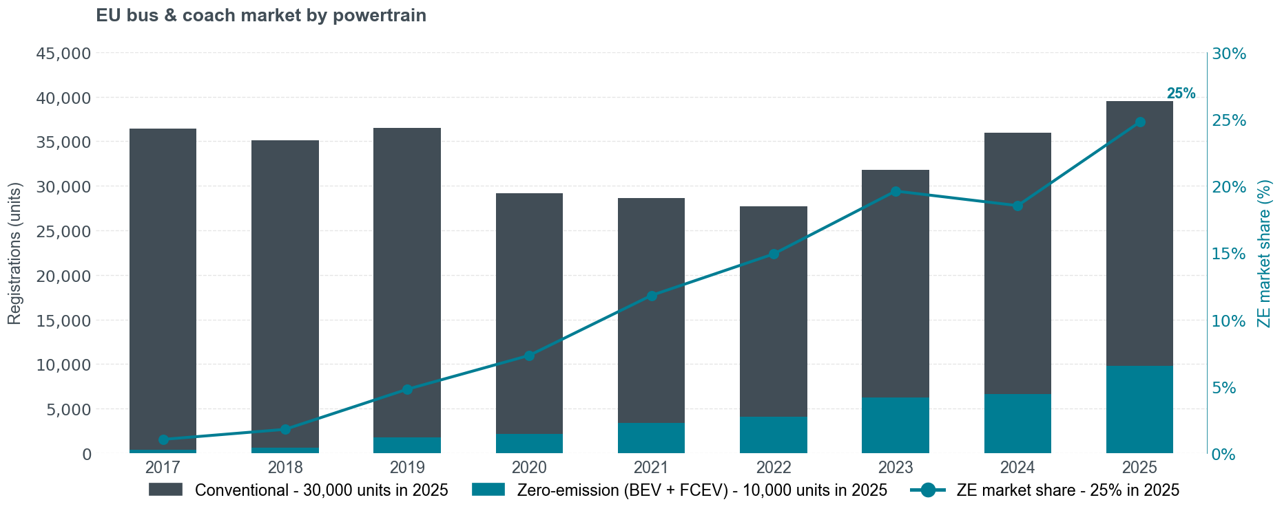
Zero-Emission Vehicle Now Account for a Quarter of EU Sales
Source: S&P (2018–2023), Dataforce (2024–2025)

Slide 4
City Buses Have Crossed the ZE Threshold; Long-Haul Remains in Early Adoption
Urban Flip: City buses passed the ZE majority mark
Gap: Coaches still in early adoption
Leaders: 11 Member states have over 80% urban ZE buses
Sales of city buses , interurban buses and coaches, and minibuses by powertrain in Q4 2025
Historic sales of zero-emission buses and coaches

Slide 5
The EU Is a Decade Behind China in Urban Buses, but Both Coach Markets Are at an Inflection Point
Urban: China near saturation (99%); EU accelerating (57%)
Coaches & Interurban: Both markets at inflection point
Sources: S&P, Dataforce (Europe); ZEDATA, Gasgoo (China)

Slide 6


China's Market Is Consolidated; the EU Coach and Interurban Buses Sector Remains Wide Open for Newcomers
China: Highly consolidated around domestic leaders across all vehicle types.
EU: Fragmented; legacy brands (Mercedes, MAN) lead urban, while new players emerge in coaches.
Key Insight: The EU coach sector remains a highly open, competitive playing field.
Sources: S&P, Dataforce (Europe); ZEDATA, Gasgoo (China)
Sales share of ZEVs by Vehicle type and manufacturer per region

Slide 7
2. EU Regulatory Landscape Supply-Side Regulations Driving the Transition

Slide 8
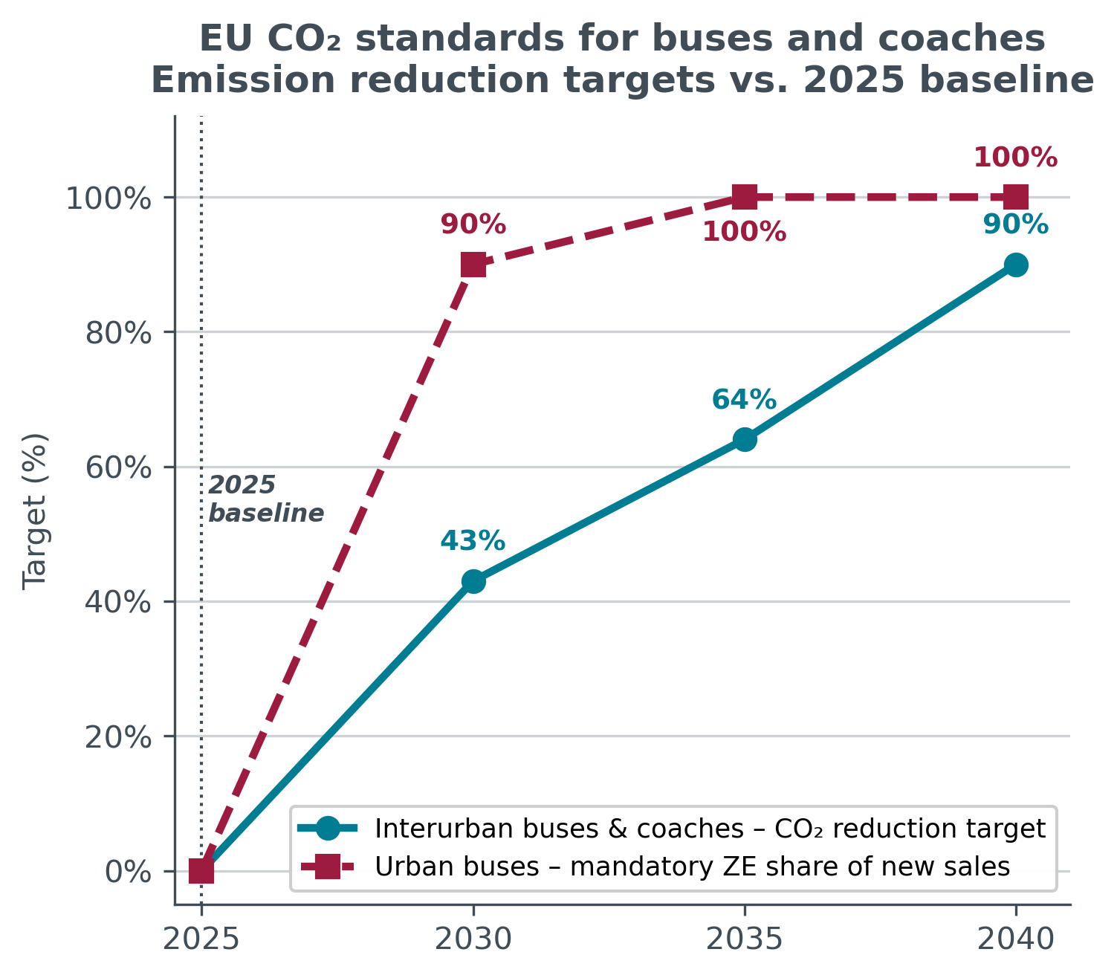
EU CO₂ Standards Split the Market: 100% ZE for City Buses by 2035, 90% CO₂ Cut for Coaches by 2040
Two-Speed Design
The regulation mirrors market maturity: a hard zero-emission mandate for city buses, a progressive CO₂ reduction path for coaches.
Urban Buses → 100% ZE by 2035
90% zero-emission sales by 2030, ramping to a full ban on combustion city buses by 2035.
Coaches → 90% CO₂ cut by 2040
No ZE mandate, but a fleet-wide CO₂ reduction target that reaches 90% in 2040 vs. the 2025 baseline.

Slide 9
Buses and Coaches Follow Separate Compliance Paths but Share One Fleet Pool
How the ZEV-derived CO₂ and VECTO-measured CO₂ feed into one penalty calculation
Urban Buses
ZEV-share derived gCO₂/tkm
Target Comparison
Fleet CO₂ vs. regulatory target
Penalty Calculation
Sum of gaps between fleet CO₂ and target
× €4,250 / gCO₂/tkm
× number of vehicles
Applied per manufacturer
Coaches & Interurban
VECTO-simulated gCO₂/tkm
2030 Targets: Buses: T = (1 − 90%) × rCO₂ref
Coaches: T = (1 − 43%) × rCO₂ref
Cross-Compensation: How the Two Pathways Interact
✓ Within-Pool Flexibility Over-complying with buses can offset shortfalls on coach CO₂ performance. Buses are significantly ahead of their ZEV targets and will likely earn credits that absorb non-compliance in the coach sector.
✘ Trucks ≠ Buses Freight and passenger are separate pools. No cross-offset possible.

Slide 10
The 2026 Targeted Amendment Eases Short-Term Compliance but Keeps All Long-Term Targets Intact
Adopted:
Commission Dec 2025
Parliament Mar 2026
Council Mar 2026
What it changes
Relaxed Credit Baseline: Credits now accrue against a flat -15% target (2025–29) rather than a tightening linear trajectory.
What stays the same
All targets intact: 43% / 64% / 90%
Bus ZEV mandate intact (90%/2030, 100%/2035)
Penalty rate: €4,250/gCO₂/tkm × vehicles
After 2030 credit mechanism

Slide 11
Euro 7 Tightens Pollutant Limits and Adds New Rules Even for Zero-Emission Vehicles
Regulation (EU) 2024/1257 - new HDV types from May 2028, all new HDVs from May 2029
Stricter tailpipe limits (WHTC)
Beyond tailpipe: what’s new
Pollutant | Euro VI | Euro 7 | Change
NOx (mg/kWh) | 460 | 200 | −56%
PM (mg/kWh) | 10 | 8 | −20%
PN | >23nm | >10nm | Smaller particle counted
NH₃ (mg/kWh) | — | 60 | New
N₂O (mg/kWh) | — | 200 | New
Extended compliance lifetime
Longer mileage + age requirements than Euro VI. Real-world durability, not just lab at type-approval.
On-board monitoring (OBM)
Real-time emission sensors on every vehicle. In-service verification, not just lab certification.
Non-exhaust emissions
First-ever limits on brake dust (PN) and tire abrasion. Applies to ALL vehicles, including ZEVs.
Real-driving NOx capped at 260 mg/kWh (-62% vs. Euro VI)
Key context
Tightens pollutant limits on ICE vehicles. Brake particle & battery durability rules also apply to ZEVs.
Battery durability
First-ever min. state-of-health for BEV/PHEV. Capacity must hold over vehicle lifetime.

Slide 12
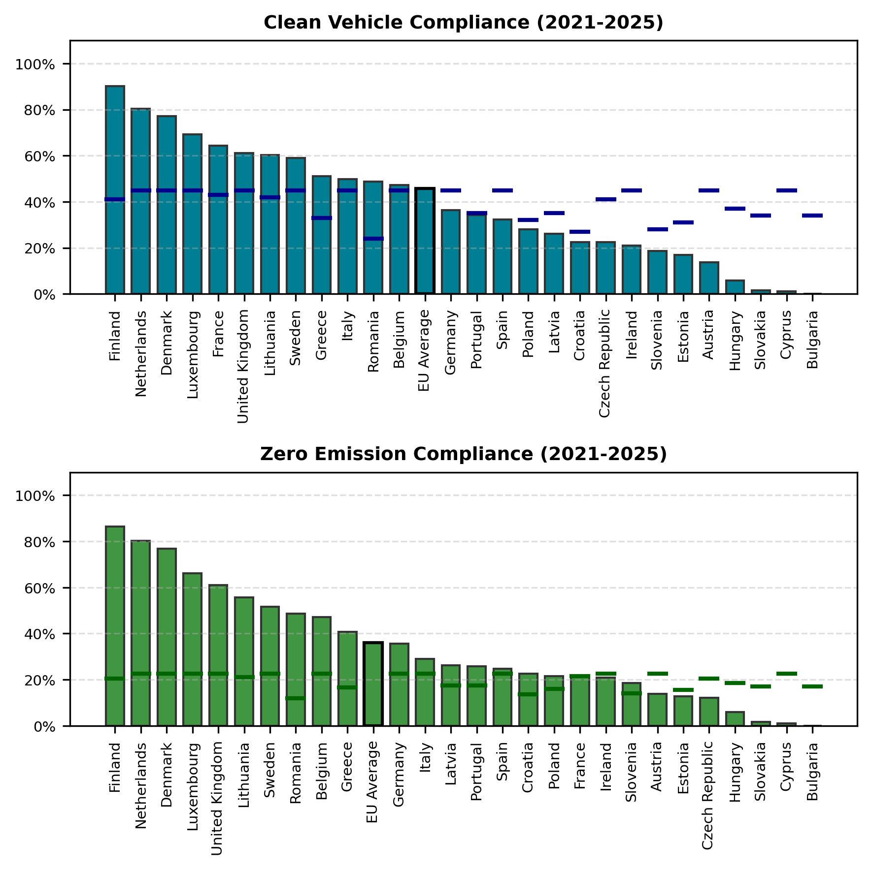
The Clean Vehicle Directive Forces Public Fleets Toward Zero-Emission Procurement
Directive (EU) 2019/1161 - first reporting period 2021-2025
The Directive at a Glance
Scope
Mandates minimum clean-vehicle and zero-emission shares in public procurement
How It Works
Per-country targets with two layers:
CV target, incl. ZEV + PHEV + gas + biofuel
ZEV sub-target, half must be BEV or fuel-cell
e.g. Germany: 45% CV, 22.5% ZEV
What’s Next
Higher targets for 2026–2030 period
Review scheduled in 2027 for post-2030 targets
Figures cover urban buses only

Slide 13
Questions ? m.benoit@theicct.org

Slide 14
ANNEX 1 : CO2 Standard Target Calculation
How the ZEV headcount mandate translates into gCO₂/pkm for penalty calculation
STEP 1
ZEV Headcount
STEP 2
ZEV Share Calculation
STEP 3
Deemed CO₂ Conversion
STEP 4
MPW Weighting
Urban Buses
ZEV or non-ZEV per vehicle
zevₛₑ = ZEV / total vehicles
CO₂ = (1 − zevₛₑ) × rCO₂ref
gCO₂/pkm → gCO₂/tkm via MPW
rCO₂ref = fleet-wide CO₂ baseline from 2025 reference period, frozen, common to all OEMs. Feeds into both pathways.
STEP 1
VECTO Simulation
STEP 2
Sub-group Average
STEP 3
MPW Weighting
STEP 4
Fleet CO₂
Coaches & interurban
gCO₂/pkm per vehicle
avgCO₂sg in gCO₂/pkm
gCO₂/pkm → gCO₂/tkm via MPW
gCO₂/tkm fleet value
pkm = passenger-km | tkm = tonne-km | ZEV ≤ 1 gCO₂/pkm | Regulation (EU) 2019/1242 consolidated 14.08.2025

Slide 15
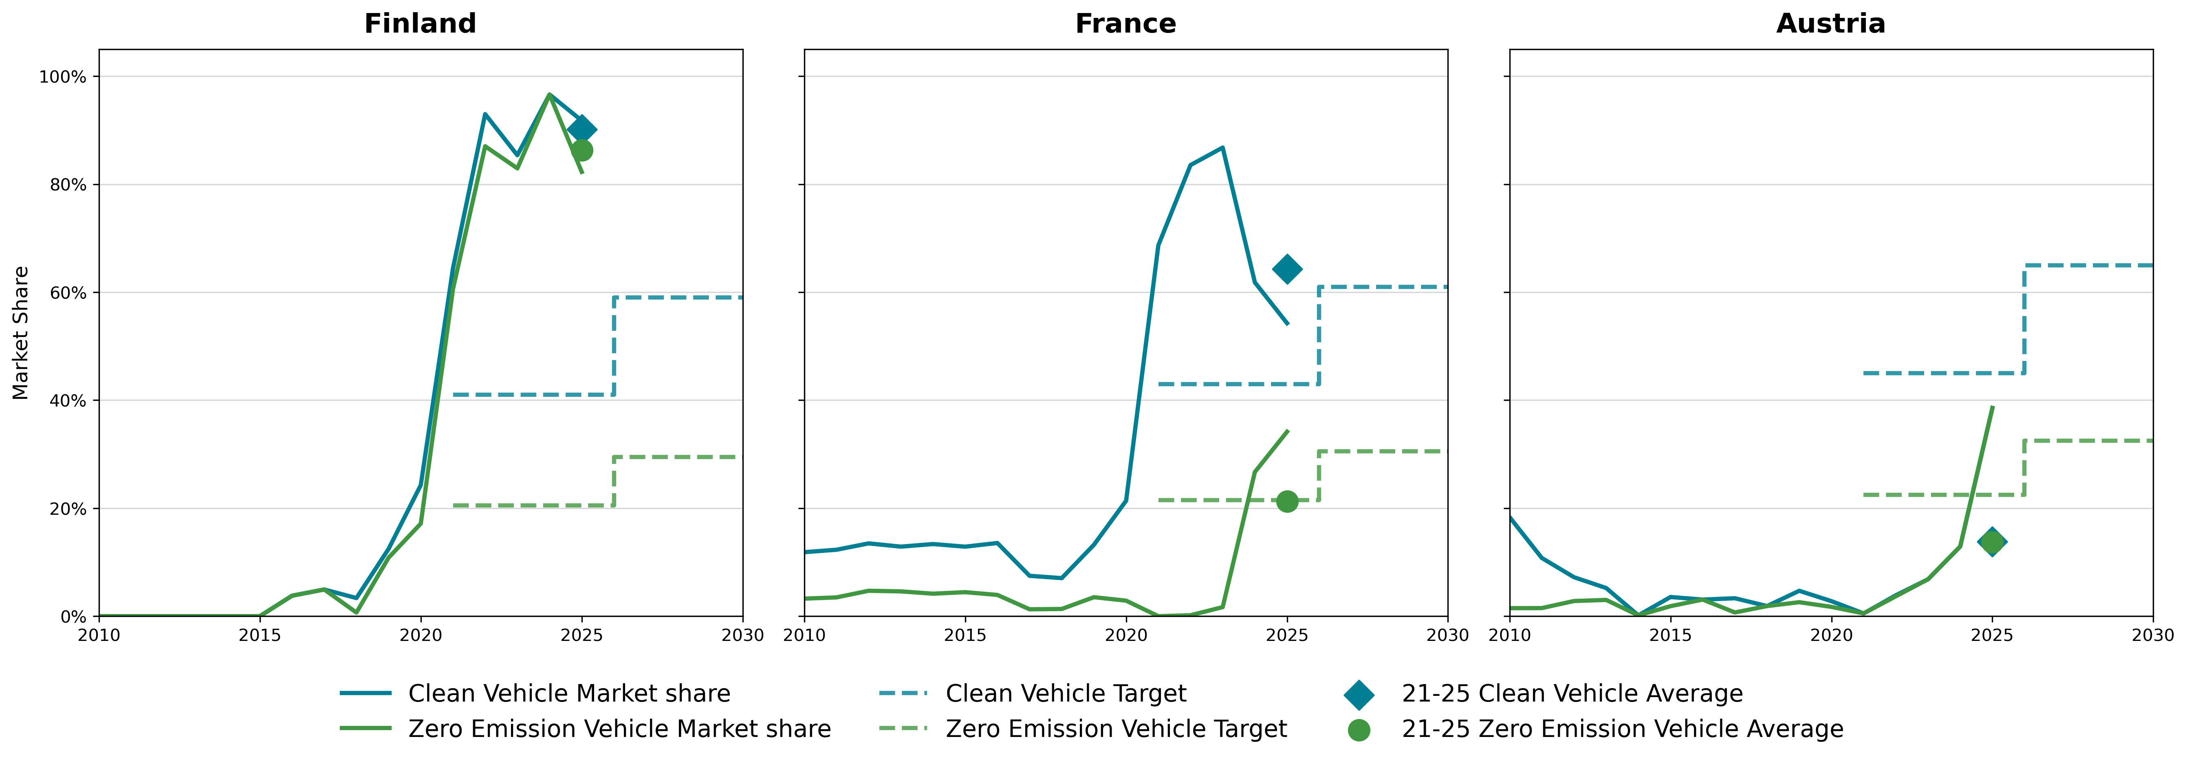
ANNEX 2 : CVD National Strategies Vary Widely
National ZE bus strategies and progress across EU Member States

